Slide 1

Graphics Introduction

Slide 2
About this lecture

Slide 3
Agenda
Hardware (GPU)
Basic Conception
Rendering
Pipeline
Summary
10 min
15 min
15 min
10 min
10 min
20 min
10 min

Slide 4
You MUST Know
3D = “Z” + 2D
Very important : PERFORMANCE

Slide 5
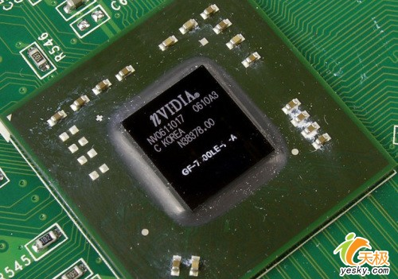
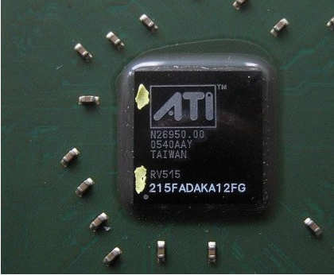
GPU is …
nVidia and ATI

Slide 6
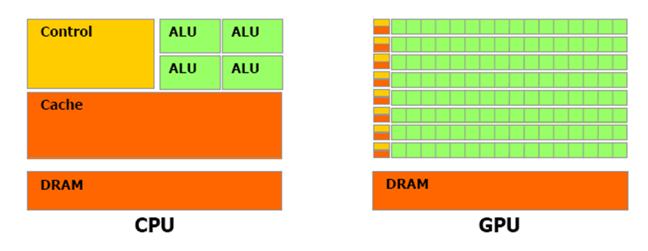
GPU & CPU
Transistors in chip

Slide 7
Rendering Type
Real-Time Rendering
Photo Realistic Rendering
Differences
Time Consuming
Realistic

Slide 8
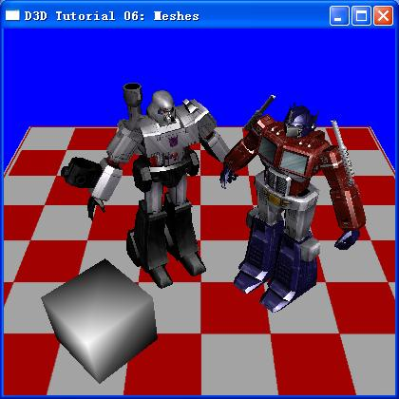
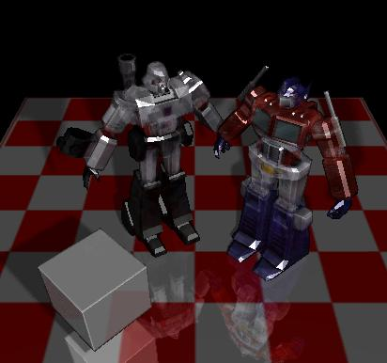
Rendering Type Sample
http://blog.csdn.net/z3m4l/archive/2007/08/16/1747111.aspx

Slide 9
Real-Time Rendering request
User interactive
Rendering Rate

